Slide 1
Event Handling

Slide 2
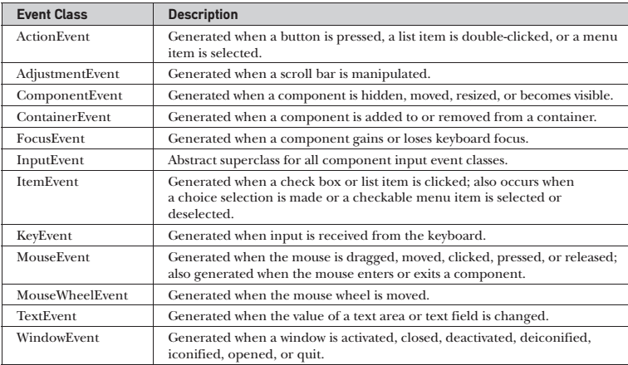
Event Classes(java.awt.event)

Slide 3
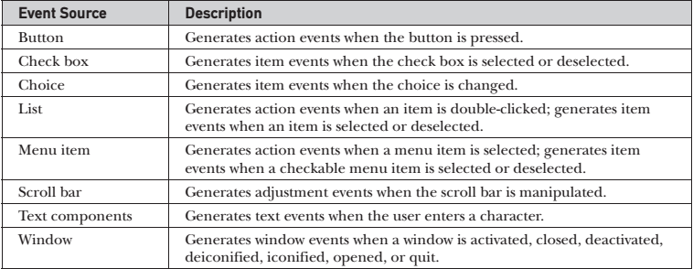
Event Sources

Slide 4
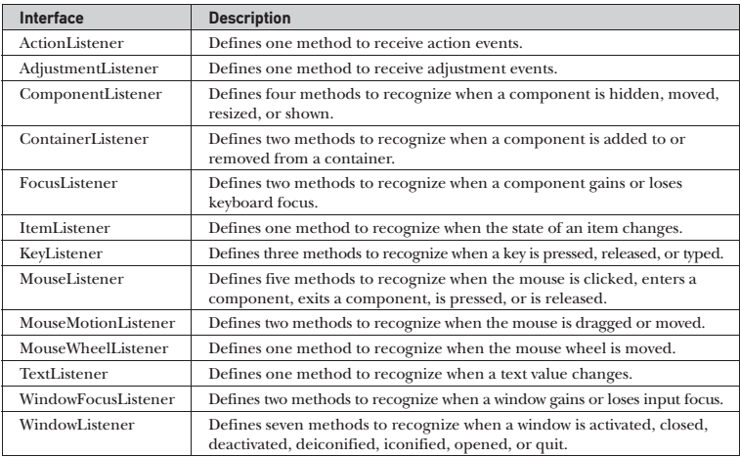
Event Listeners

Slide 5
Action Listener
void actionPerformed(ActionEvent ae)

Slide 6
AdjustmentListener
void adjustmentValueChanged(AdjustmentEvent ae)

Slide 7
ComponentListener
void componentResized(ComponentEvent ce)
void componentMoved(ComponentEvent ce)
void componentShown(ComponentEvent ce)
void componentHidden(ComponentEvent ce)

Slide 8
ContainerListener
void componentAdded(ContainerEvent ce)
void componentRemoved(ContainerEvent ce)

Slide 9
FocusListener
void focusGained(FocusEvent fe)
void focusLost(FocusEvent fe)

Slide 10
ItemListener
void itemStateChanged(ItemEvent ie)

Slide 11
KeyListener
void keyPressed(KeyEvent ke)
void keyReleased(KeyEvent ke)
void keyTyped(KeyEvent ke)

Slide 12
MouseListener
void mouseClicked(MouseEvent me)
void mouseEntered(MouseEvent me)
void mouseExited(MouseEvent me)
void mousePressed(MouseEvent me)
void mouseReleased(MouseEvent me)

Slide 13
MouseMotionListener
void mouseDragged(MouseEvent me)
void mouseMoved(MouseEvent me)

Slide 14
MouseWheelListener
void mouseWheelMoved(MouseWheelEvent mwe)

Slide 15
TextListener
void textValueChanged(TextEvent te)

Slide 16
WindowFocusListener
void windowGainedFocus(WindowEvent we)
void windowLostFocus(WindowEvent we)

Slide 17
WindowListener
void windowActivated(WindowEvent we)
void windowClosed(WindowEvent we)
void windowClosing(WindowEvent we)
void windowDeactivated(WindowEvent we)
void windowDeiconified(WindowEvent we)
void windowIconified(WindowEvent we)
void windowOpened(WindowEvent we)

